Slide 1
MENDELEEV’S PERIODIC LAW AND PERIODIC TABLE
Mendeleev’s periodic law:Dmitry Mendeleev a Russian chemist while trying to classify elements discovered that on arranging in the increasing order of atomic mass, elements with similar chemical properties occurred periodically. In1869,he stated this observation in the following form which is known as Mendeleev’s Periodic Law- “The chemical and physical properties of elements are a periodic function of their atomic masses.”
Main features:1. The horizontal rows present in the periodic table are called periods. There are seven periods in the periodic table.(Arabic numerals)
2. Properties of elements in a particular period show regular gradation from left to right.
3. The vertical columns present in it are called groups . These are nine in number and are numbered from I to VIII and Zero (Roman numerals).
4. Groups I to VII are subdivided into A and B subgroups. Groups Zero and VIII don’t have any subgroups.
5. All the elements in a particular group are chemically similar in nature. They show regular gradation in their physical properties and chemical reactivities.

Slide 2
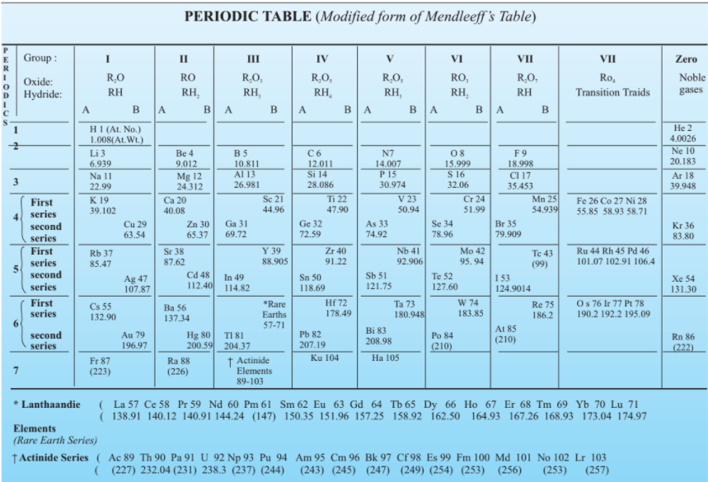
Merits:1.It was the first classification to include all the elements.
2. Mendeleev’s periodic table had some blank spaces in it. These vacant spaces were for elements that were yet to be discovered. For example, he proposed the existence of an unknown element that he called eka-aluminium . The element gallium was discovered four years later and its properties matched very closely with the predicted properties of eka-aluminium.
Defects:1.Position of Hydrogen-Alkali/Halogens
2.Position of Isotopes-Different isotopes of same elements have different atomic masses, therefore, each one of them should be given a different position in the periodic table. On the other hand,because they are chemically similar, they had to be given same position.
3. At certain places, an element of higher atomic mass has been placed before an element of lower atomic mass. For example, Argon (39.91) is placed before potassium (39.1).

